Slide 1
Contract Monthly Claim System (CMCS)
Dean Sibley
ST10440750

Slide 2
Project Evolution & Improvements
Part 2: Basic in-memory storage system, No Database and visually dull
Part 3: Full database integration with enhanced features
Key Improvements:
  User Friendly UI
  Database integration using SSMS
  Role based Access Control
  Able to upload, View and download files

Slide 3
System Architecture
Presentation Layer: Views and CSS
Logic Layer:
Controllers, Models and Services
Data Access Layer:
Entity Framework & SQL Server
The system is built on a robust technical stack utilizing ASP.NET Core MVC for the web framework, Entity Framework Core for database operations, and SQL Server for data storage, complemented by Bootstrap 5 and Font Awesome for a responsive and modern user interface, with QuestPDF enabling professional reporting capabilities.

Slide 4
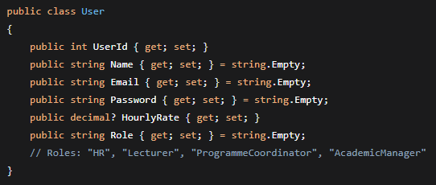
Multi-role Loging
The system has four different user roles: Academic Managers provide final approval, authorize payments, and oversee finances; HR Administrators manage user management, system reporting, and account activation; Lecturers submit claims, upload documents, and monitor status; Program Coordinators verify claims, provide initial approval/rejection, and ensure quality.
Based on the extract each user is assigned a role.

Slide 5
Lecturer workflow
Real-time amount calculation that automatically calculates claim totals, thorough file validation that supports PDF, DOC, and image formats with a 5MB size limit, hours worked validation that enforces a maximum of 180 hours per claim, and automatic status updates that monitor each claim's progress through the approval workflow are just a few of the system's key features.

Slide 6
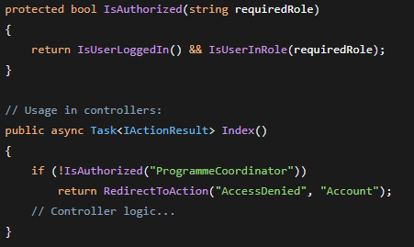
Improved Validation and security
Furthermore Strong security mechanisms are implemented by the system, such as secure session management for user authentication, anti-forgery tokens to stop CSRF attacks, role-based authorisation to govern access, and secured file uploads with validation to guarantee document safekeeping.
Above method checks if: 1# The User is Logged in and 2# If the User is Assigned a role

Slide 7
WEALTH IS THE ABILITY TO FULLY EXPERIENCE LIFE.
-Henry David Thoreau

Slide 8
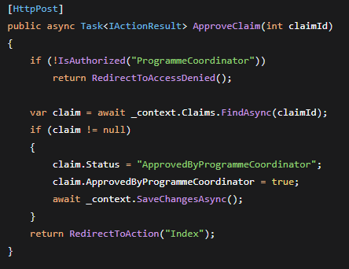
Programme Coordinator
The Programme Coordinator's View is equipped with:
Pending claims dashboard
Rejection reason tracking
Document preview functionality
Example of this is the following method which checks if the user is authorized to approve the claim

Slide 9
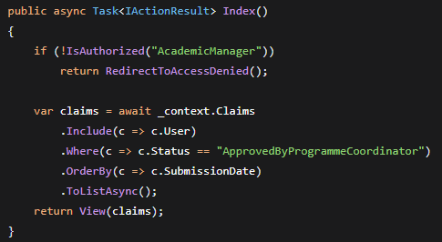
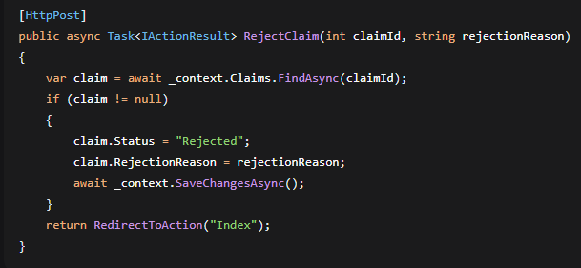
Academic Manager
The Index() method filters the database to display only claims with the "ApprovedByProgrammeCoordinator" status, including user information for display reasons, and shows all claims that have been approved by Programme Coordinators and are pending final Academic Manager evaluation.
In order to ensure appropriate documentation for the reasons a claim was rejected during the final approval stage, the RejectClaim() function updates the claim status to "Rejected" and stores the given rejection reason in the database.

Slide 10
UI DESIGN
Simplicity
Colours
Icons
Backgrounds
Animatation
The overall flow of the web app is smooth making it difficult for users to get lost or confused
Matching different buttons, messages, tests with its own distinctive colour creates an environment where the user already knows what's happening before even reading
Majority of the icons used appear in the actions column in most tables. This creates space as now there would be no need to type out the actions. E.g. an eye icon instead of displaying “View”
Although the animated backgrounds don’t add much functional value they definitely add value visually
Animated buttons and notifications Help make the web app feel less generic and plain which is definitely noticed by the user

Slide 11
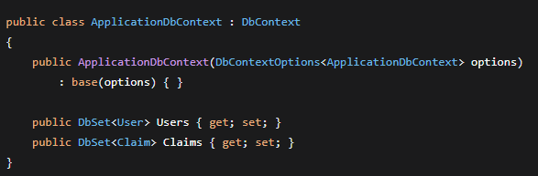
Database Schema & Data Flow Code 1/2
Goal: Using Entity Framework Core Constructor, this class acts as the primary link between your application and the database.
Constructor:takes DbContextOptions for configuration (connection strings, database provider) and inherits from DbContext.
DbSet Properties:
  Users represents the Users table in SQL Server
  Claims represents the Users table in SQL Server

Slide 12
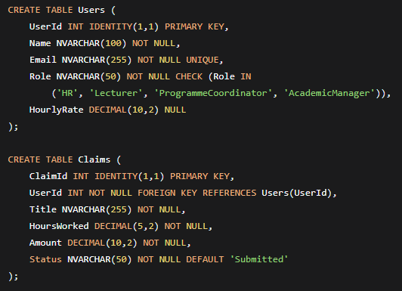
Database Schema & Data Flow Code 2/2
Claims table Breakdown:
ClaimID- Primary Key, Auto Increments
UserID – Foreign Key, Creates Relationship To User table
HoursWorked – Decimal for less than an hour
Amount - Decimal for monetary values
Status - ensures new claims start as "Submitted"

Slide 13
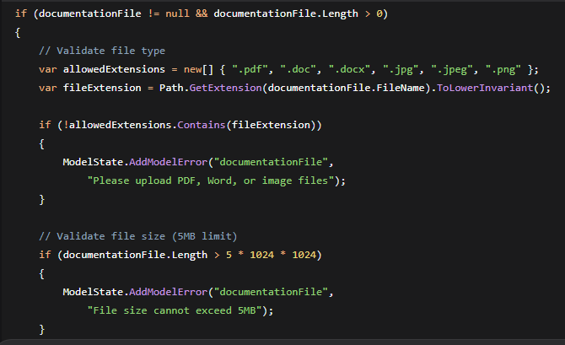
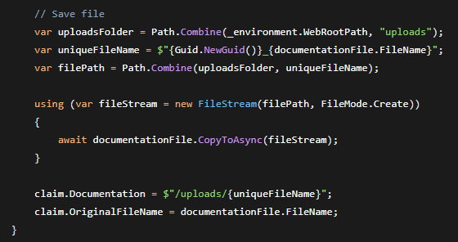
File Upload
File upload main Details:
File Validation - Only authorized file types such as PDFs, Word documents, and images are accepted; potentially hazardous formats are blocked by a whitelist system.
Size Control - While preserving the best possible system performance and upload rates, a stringent 5MB file size limit safeguards server resources.
Organized Tracking - To ensure systematic document retrieval and easy user reference, we save both original filenames and secure file paths.

Slide 14
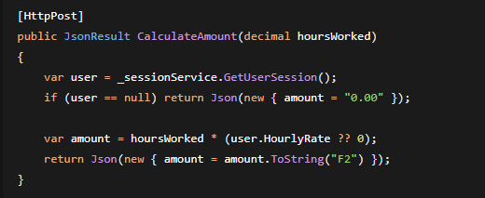
Amount Calculations and UX Code 1/2
Server-side amount computation is handled via a specialized JSON method that combines the user's stored hourly rate with the number of hours worked. This server validation keeps the user experience responsive while preventing client-side manipulation.

Slide 15
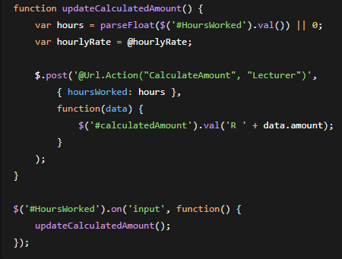
Amount Calculations and UX Code 2/2
Dynamic User Interface - The interface provides real-time visual feedback by dynamically updating estimated quantities and character counts. In order to avoid duplicate entries, form submission is intelligently prevented during processing.
Enhanced User Experience - A smooth workflow is produced by real-time computations and validation, which lowers errors and speeds up form completion. Through server-side verification, the system preserves timeliness while guaranteeing data integrity.

